Slide 1
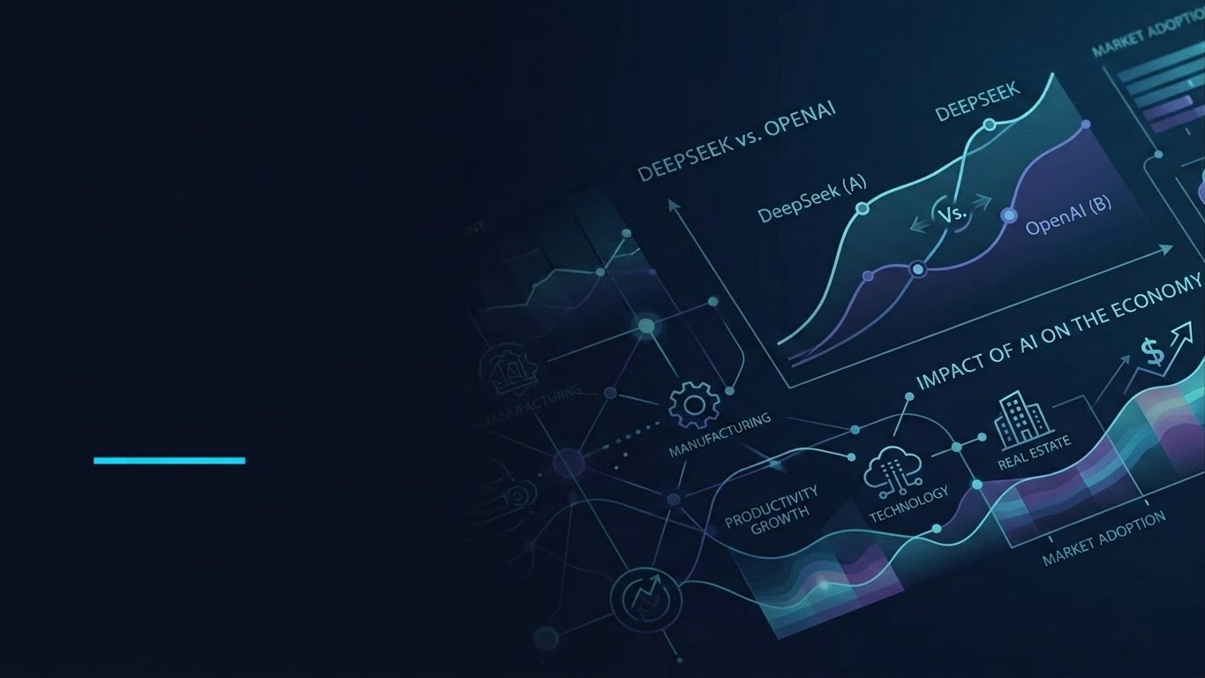
DEEPSEEK VS OPENAI
What Is The Impact of AI On The Economy?
Flexibility. Access. Responsible building.
Group Project 1
Notes:
Our topic is DeepSeek and OpenAI, with a focus on what open-weight AI could mean for people who build software.

Slide 2
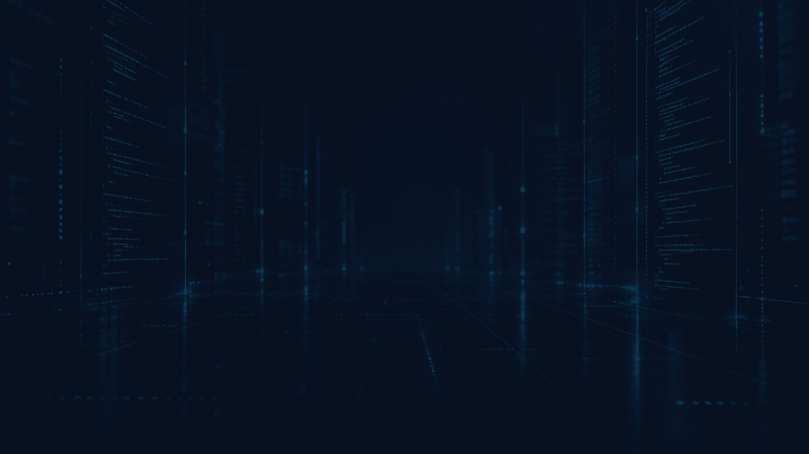
Open-Weight Models: More Developer Choice
BUILD ON IT
More flexibility to create AI-powered software
Explore and adapt model weights for your project.
→
Customize AI behavior for specific application needs.
→
Rely less on one closed, proprietary service.
→
DeepSeek vs OpenAI
Notes:
One difference is flexibility. Open-weight models let developers explore the available weights and adapt a model for a project. That can give us more control over how an AI feature behaves, instead of relying only on a closed service with fixed options.

Slide 3

How DeepSeek Reduced Training Costs
$5.6 MILLION US DOLLARS
Estimated H800 GPU cost for DeepSeek-V3’s official training run
➔ This is a reported computing-cost estimate, not DeepSeek’s total R&D spending.
➔ It demonstrated how efficient AI architectures can reduce computational requirements.
Source: DeepSeek-V3 Technical Report (2024)
DeepSeek vs OpenAI

Slide 4
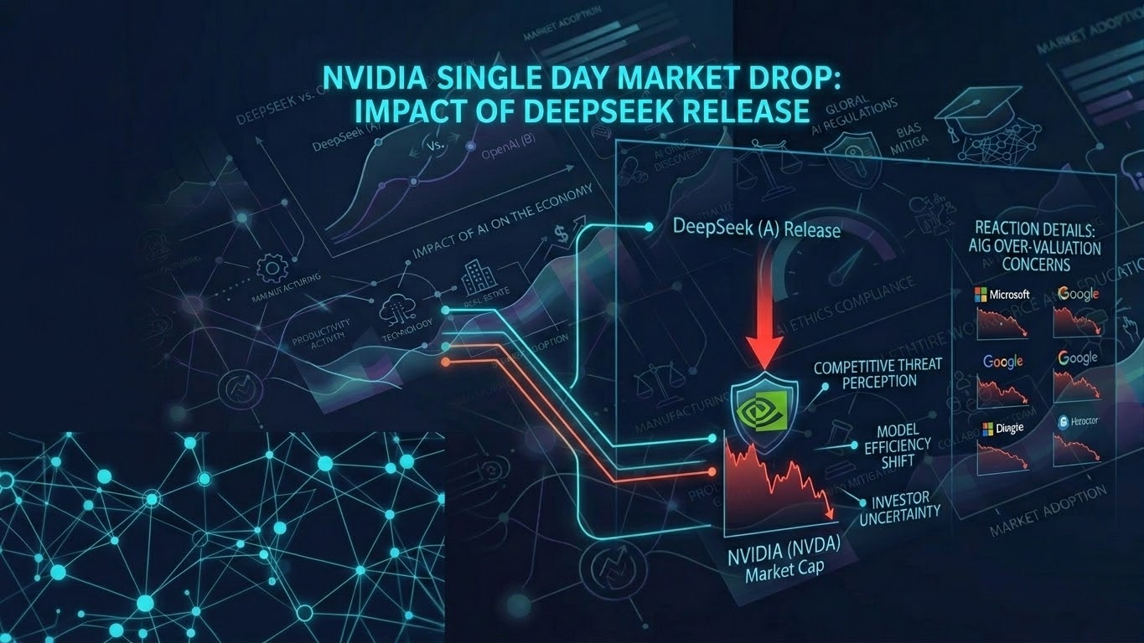
January 27, 2025
US$593 BILLION LOST
Nvidia’s market-value loss in one trading session
➔ Investors questioned whether AI progress would always demand massive hardware investments.
➔ The news broadened the debate about competition, innovation, and the economics of AI.
Source: Reuters, citing LSEG data (January 27, 2025)
DeepSeek vs OpenAI

Slide 5

Impact on Software Development
BUILD, CUSTOMIZE, EXPAND ACCESS
➔ Open-weight models give developers more flexibility to build and customize AI-powered applications.
➔ Efficient models can make advanced AI more accessible to smaller companies, independent developers, and students.
➔ Useful examples include coding assistants, automated workflows, and intelligent applications.
➔ Privacy, security, and the accuracy of AI-generated results still require careful review.
DeepSeek vs OpenAI

Slide 6

Conclusion
SMARTER, NOT JUST BIGGER
A new way to think about AI innovation
Advanced AI can benefit from efficient architectures.
→
Training innovation can expand access to useful tools.
→
Progress means solving hard problems more thoughtfully.
→
Thank you for watching.
DeepSeek vs OpenAI
Notes:
DeepSeek challenged the idea that advanced artificial intelligence always depends on enormous financial investment. Its example highlights efficient architectures, innovative training methods, and broader access to AI tools. For developers, the key lesson is that progress is not only about spending more; it is about finding smarter ways to solve complex problems. Thank you for watching.

